Slide 1







Student Activity Account Training
Presented by: Ron Martin, Accounting Staff, Donna Johnson and Beverly Foster
Date of Training: January 2017

Slide 2
Student Activity Accounts
  The student activity funds shall be collected and disbursed under the general direction of the building principal.
  However, the principal shall involve those student groups, faculty and staff members who are responsible for the necessary aspects of the approved activities.
Notes:
Student Activity Accounts under Principal’s direction
with student groups, faculty and staff members involvement

Slide 3
Student Activity Accounts
  The student activity funds will operate with a separate tracking for each different activity at the building level.
  Each specific account will be operated by student organizations and classes under the supervision of faculty advisers.
Notes:
Track by student activity
Faculty advisors supervise student organizations

Slide 4
Receipts
  Cash receipts will be pre-numbered receipt forms
  Moneys for deposit are to be presented to the building principal or his/her designee on a daily basis.
  All deposits will have an approved deposit receipt, prepared in duplicate, showing the organization to be credited, the amount for deposit and signed by the staff member presenting the deposit.
Notes:
Use pre-numbered receipts
Present checks and cash received daily
Duplicate signed deposit receipts

Slide 5
Receipts
  The deposit is to be verified by the person accepting the moneys who will sign the receipt
  The duplicate will be returned to the organization and maintained in the organization's records until an official receipt is received from the district office
  All checks should be endorsed "For Deposit Only“
  Bank deposits should be made within 3 days of receipt
Notes:
Deposits verified by receiver of moneys
Endorse “For Deposit Only”
Bank deposits within 3 days

Slide 6
Receipts
  Cash deposits must be verified by at least two people
  Moneys received are to be kept in the safe until deposited in the bank
  Amounts kept in the safe should be minimal with daily bank deposits made during sales campaigns
  After moneys are deposited in the bank, the amount should be entered in the ledger account
Notes:
Two people verify bank deposits
Keep in safe
Daily deposits with high activity
Ledger entry after deposits

Slide 7
Quiz
  Cash receipts will be entered on what kind of receipt forms?
  How should checks be endorsed?
  How often should bank deposits be made and where should they be kept until the deposit is made
Notes:
Pre-numbered
For Deposit Only
Daily or at least every 3 days
Kept in safe

Slide 8
Disbursements
  Use pre-numbered checks and two original signatures (no signature stamps)
  All voided checks should be clearly marked "Void" with the signature portion removed from the check
  Requests for checks are to be submitted on a disbursing order showing the organization to be charged, the amount of the check, the name and address of the payee and the purpose of the disbursement
Notes:
Pre-numbered checks
2 signatures
Mark checks as void and remove signature lines
Use disbursing orders

Slide 9
Disbursements
  Checks must have two signatures of which one must be the Principal.
  One of the two people must be the other signer: Another staff member or the secretary or the book clerk treasurer.
  Checks will not be issued for any amount in excess of the balance maintained by the organization. Schools are responsible for displaying the District's tax exempt form for all purchases.
  Any sales tax charges submitted for reimbursement will be denied.
Notes:
Principal and staff member signers
Use tax exempt form
No sales tax reimbursed

Slide 10
Quiz
  How should voided checks be handled?
  How many check signers should be used and who should they be?
Notes:
Mark as void and remove signature lines
Two Principle and AP or Bookkeeper

Slide 11
Interest
  Activity funds will be maintained as interest bearing accounts, unless bank fees exceed interest earned.
  Interest earned by the accounts will be credited to the various organizations on a quarterly basis.
  Interest will be distributed on the basis of each organizations share of the account balance at the end of the quarter.
Notes:
Allocate interest by activity account balance

Slide 12
Reporting
  Bank reconciliations will be performed monthly by the school's Principal, secretary or book clerk treasurer.
  The ending bank statement balance must reconcile to the balance on the ledger balance/cash transaction sheet ledger.
  The school must maintain a listing of outstanding checks and a sub-ledger for each separate activity account.
  The monthly totals of the sub-account ledgers must reconcile to the total listed on the monthly trial balance.
Notes:
Bank recs monthly
Reconcile ending bank statement balance to ending ledger balance

Slide 13
Reporting
  Each month for the high schools and middle schools, copies of the ledger, bank statement and bank reconciliation should be forwarded to the Fiscal Control Office.
  Elementary schools should submit at the end of each quarter.
Notes:
This is a change
Middle and High Schools Monthly
Elementary Schools quarterly

Slide 14
Reporting
  A monthly report of all receipts, disbursements and current balances will be prepared in the district office and forwarded to the building principal and faculty advisers of each organization.
  In addition, the corresponding receipts and disbursements will be posted to the General Ledger on a quarterly basis.
Notes:
Share reports with faculty advisors

Slide 15
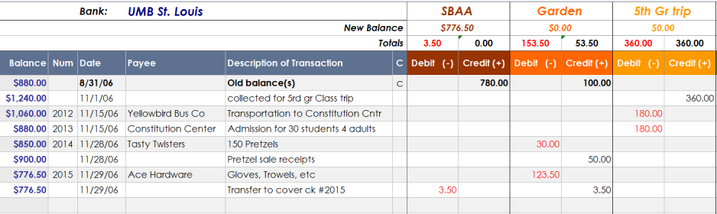
Student Activity Ledger
Notes:
Kevin, Ronnie or Armando walk through filling out ledger

Slide 16
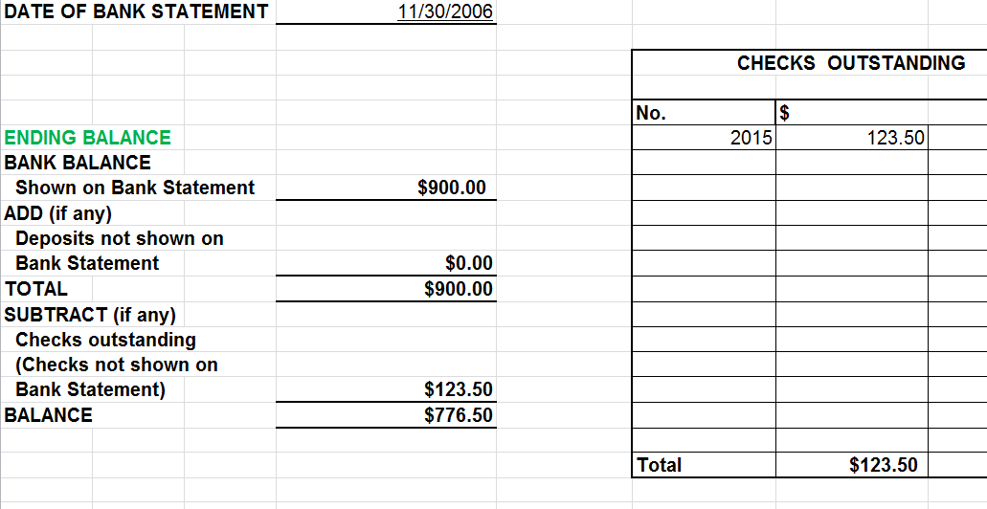
Bank Reconciliation
Notes:
Kevin, Ronnie or Armando walk through filling out bank rec.

Slide 17
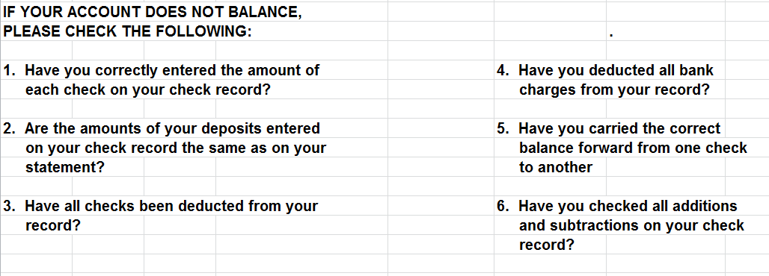
Bank Reconciliation
Notes:
Kevin, Ronnie or Armando - Helpful hints to balance bank rec.

Slide 18
Quiz
  How often should bank reconciliations be performed?
  How often should your school submit reports to Fiscal Control?
  Who should review the monthly report of all receipts, disbursements and current balances?
Notes:
Monthly
Middle and High Schools monthly
Elementary schools quarterly
Principal

Slide 19
Use of Activity Funds
  The student activity fund will not be used for small cash and check needs of other funds and organizations.
  Student activity funds should be used solely for their intended purposes, for the benefit of the students
Notes:
Donna - For the benefit of the students not staff food or incentives

Slide 20
Initiating/Terminating Accounts
  New programs, clubs or organizations may be added as new accounts with the approval of the building principal.
  New accounts should not be established solely for individual charitable drives.
  Requests to the principals should be in writing and occur only after a need for the new account is determined.
  BANK ACCOUNTS ARE AUTHORIZED ONLY AT BANKS DETERMINED BY FISCAL CONTROL/TREASURY
Notes:
Donna - Principal approves new activities
To be determined on moving banks to US Bank
Send bank statements for accounts we have not previously received

Slide 21
Cash Payments
  All payments for activity fund purchases should be made by check.
  No expenses should be paid in cash directly from dues, collections, sales or other cash receipts.
  Checks will not be made payable to "Cash."
  Blank pre-signed checks cannot be issued.
  Debits/withdrawals cannot be made at the bank counter.
  Credit/debit/ATM card transactions cannot be made.
Notes:
Donna - No cash payments
No debit cards

Slide 22
Loans and Purchases
  Student activity funds shall not be used to make loans for any purpose.
  Student activity funds will not be used to make purchases by an individual for other organizations.
  It is against policy to use student activity funds to make privileged or tax-free purchases for any school employee or other person.
Notes:
No loans
No tax free purchases for anyone

Slide 23
Bidding
  District policy requires that purchases of materials or supplies by any organization, club, class or group in excess of five thousand dollars ($5,000) shall be made upon solicitation of three or more quotations or bids.
  Purchases must be made from the lowest responsible bidder on the basis of price, quality and service.
  Purchases over $5,000 require approval by the Board.
Notes:
Purchases over $5,000 3 bids and board approval

Slide 24
Bidding
  Services such as those of prom hotels and music groups are not subject to bidding.
  Purchases of materials such as rings, yearbooks and pictures, if made directly by the students and no transactions go through the student activity funds, will not require bidding.
  If they are purchased through the student activity fund, bidding is required.
  Long-term contracts may be desirable and service should certainly be considered when reviewing bids.
Notes:
Prom hotels and music exempt from bids
Rings, yearbooks & pictures outside of student account exempt from bids

Slide 25
Contracts
  Student groups may obligate themselves by contracts for services with the approval of the faculty adviser, the building principal and the superintendent provided that legal requirements for bidding and district policies are followed.
  Contracts, presented by vendors such as musical groups and yearbook publishers, should be reviewed by Fiscal Control and/or solicitor, as well as by the principal.
Notes:
Advisor, Principal and Superintendent approve contracts
Contracts outside of student account reviewed by
Solicitor, principal and fiscal control
Contact Terry Bullock with questions

Slide 26
Quiz
  When should cash payments be made?
  What dollar amount requires purchases to be approved by the Board?
Notes:
Never
$5,000

Slide 27
Petty Cash
  The student activity funds will not have any petty cash funds.
Notes:
No petty cash

Slide 28
Unused Funds
  When the interest of membership in a student club or organization funded by the students themselves declines to the point where organizational activities cease and there is a financial balance in the account, the money will be returned to the remaining club members if they are still in school and can be identified readily as having contributed to the balance, or the balance may be transferred to the general activity.
Notes:
Unused funds to students or to general account

Slide 29
Commissions and Non-School Funds
  The purchase of items for which commissions are paid will be avoided. A reduced sale price shall replace commissions.
  The student activity funds are not to be utilized for such non-school funds as faculty accounts, booster club accounts, PTA/PTO accounts and the like.
Notes:
No commission payments
Not for faculty, booster club or PTA/PTO accounts
Move toward separate bank accounts for PTO

Slide 30
Employees
  All school district employees who are to be paid for duties performed at a function of a student organization will be paid through the district's payroll with regular deductions.
  When necessary, the student organization will reimburse the general fund for the payments
Notes:
No employee payments
Go through payroll

Slide 31
Quiz
  Is petty cash allowed?
  Is it appropriate to pay commissions?
  How are employees to be paid?
Notes:
No
No
Payroll

Slide 32
Fundraising Activities
  The Principal will have overall supervision of all fundraising activities that take place on school grounds, whether organized and sponsored by the school, parent organization or both.
  The Principal must be an authorized signer on all bank accounts for the school but not a parent organization.
Notes:
Principal supervised all fundraising activities
Not a check signer for PTO accounts

Slide 33
Fundraising Activities
  The Principal must maintain a completed Fundraising Approval Form on file for each planned activity.
  This form should include a description of the activity, a statement of the fundraiser's purpose, the anticipated gross receipts and net proceeds and copies of any contractual agreements relating to the activity.
Notes:
Fund raisers approved by principal and network superintendent
Need a budget for the fundraiser

Slide 34
Notes:
Walk through form

Slide 35
Notes:
Walk through form

Slide 36
Fundraising Activities
  All refunds will only be made by check and will only be made provided the appropriate documentation is presented.
  Upon completion of the fundraising activity, the Principal should maintain on file a summary detailing the net proceeds, certification that all expenses have been paid and a statement that the proceeds will be used as previously stated on the Approval form.
Notes:
Refunds by check
Actual results of fundraiser

Slide 37
Notes:
Walk through form

Slide 38
Fundraising Activities
  The parent organization is entitled to receive all proceeds from activities organized and sponsored solely by the parent organization.
  Activities held on school grounds must be approved in advance by the Principal, and, upon completion of the event, a final report must be submitted to the Principal
Notes:
PTO’s to receive proceeds raised
Funds raised can only be used for that activity

Slide 39
Quiz
  Who is in charge of fundraising?
  Is there a required fundraising form?
  Can parent organizations hold fundraisers on school grounds and if so who should approve in advance?
Notes:
Principal
Yes
Yes Principal

Slide 40
GOB Expenditures
  All expenditures that do not benefit the students should be requested using a voucher certification from your GOB budget.
Notes:
Beverly - If not student related use GOB

Slide 41
Notes:
Beverly walk through procedures

Slide 42
Notes:
Beverly walk through form

